Slide 1
COMP10001
Week 6
With Lucy

Slide 2
First, some revision!

Slide 3
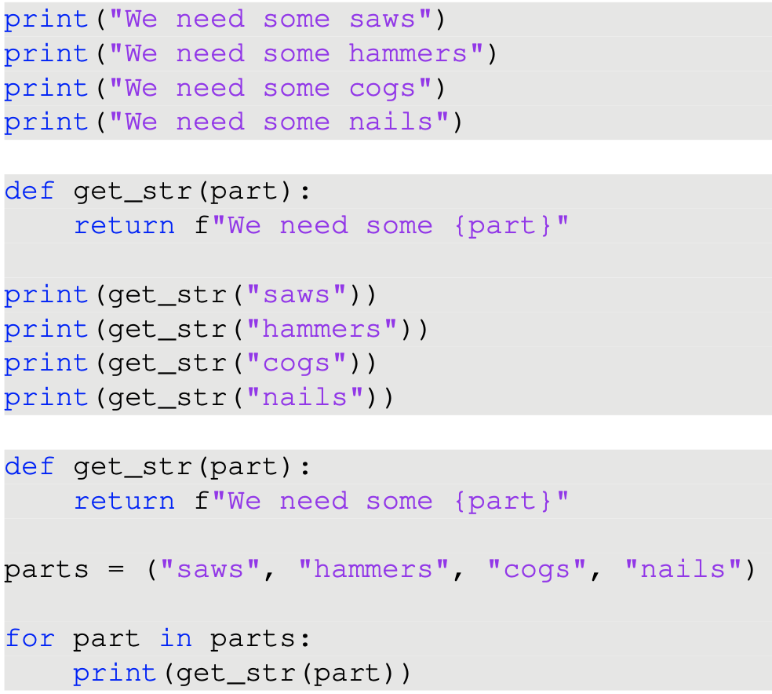
Do the following snippets do the same thing?
What are their advantages/disadvantages?

Slide 4
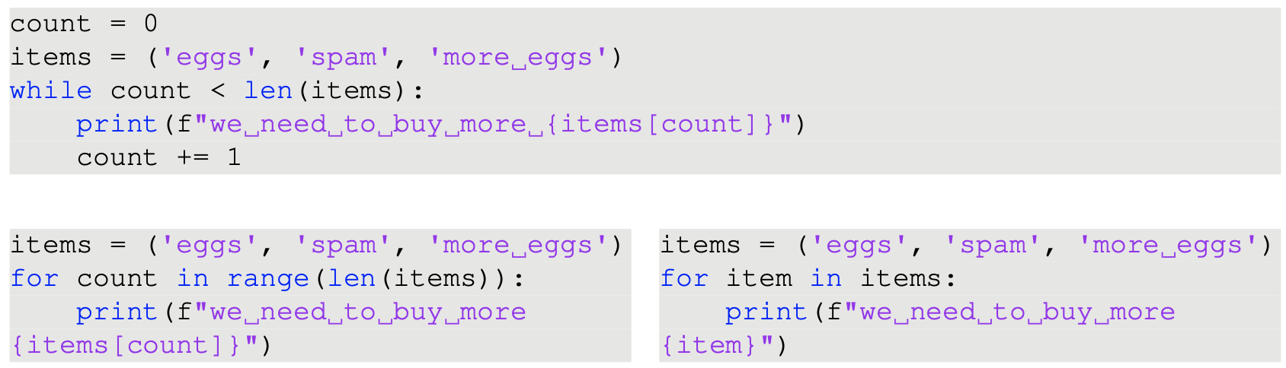
Consider the following loops. Are the two for loops equivalent? Why might you choose one over the other?

Slide 5
Dictionaries and sets

Slide 6
When should we use a dictionary? How is it structured? How do we add and delete items?

Slide 7
When should we use a dictionary? How is it structured? How do we add and delete items?
Dictionaries hold pairs of keys and values

Slide 8
When should we use a dictionary? How is it structured? How do we add and delete items?
Dictionaries hold pairs of keys and values
Useful for counting frequencies, storing information about unique items
Access values with index notation: dictionary_name[key] gives value

Slide 9
When should we use a dictionary? How is it structured? How do we add and delete items?
Dictionaries hold pairs of keys and values
Useful for counting frequencies, storing information about unique items
Access values with index notation: dictionary_name[key] gives value
Add values by declaring a key value pair: dictionary_name[key] = value
Remove values with .pop(): dictionary_name.pop(key)

Slide 10
What is the difference between using the .pop() method on a dictionary and using it on a list?
List
.pop() called without an index argument removes the last item in the list
.pop(index) removes the item in the list at that index
Dictionary
.pop(key) deletes the key:value pair associated with that key in a dictionary
.pop() called without a key on a dictionary raises an error
Notes:
No inherent ordering of key:value pairs in dictionaries

Slide 11
What is the difference between using the .pop() method on a dictionary and using it on a list?
List
.pop() called without an index argument removes the last item in the list
.pop(index) removes the item in the list at that index
Dictionary
.pop(key) deletes the key:value pair associated with that key in a dictionary
.pop() called without a key on a dictionary raises an error
Notes:
No inherent ordering of key:value pairs in dictionaries

Slide 12
What is the difference between using the .pop() method on a dictionary and using it on a list?
List
.pop() called without an index argument removes the last item in the list
.pop(index) removes the item in the list at that index
Dictionary
.pop(key) deletes the key:value pair associated with that key in a dictionary
.pop() called without a key on a dictionary raises an error
Notes:
No inherent ordering of key:value pairs in dictionaries

Slide 13
What is the difference between using the .pop() method on a dictionary and using it on a list?
List
.pop() called without an index argument removes the last item in the list
.pop(index) removes the item in the list at that index
Dictionary
.pop(key) deletes the key:value pair associated with that key in a dictionary
.pop() called without a key on a dictionary raises an error
Notes:
No inherent ordering of key:value pairs in dictionaries

Slide 14
What is the difference between using the .pop() method on a dictionary and using it on a list?
List
.pop() called without an index argument removes the last item in the list
.pop(index) removes the item in the list at that index
Dictionary
.pop(key) deletes the key:value pair associated with that key in a dictionary
.pop() called without a key on a dictionary raises an error
Notes:
No inherent ordering of key:value pairs in dictionaries

Slide 15
When should we use a set? How do sets differ from lists and dictionaries?

Slide 16
When should we use a set? How do sets differ from lists and dictionaries?
Sets store collections of unique objects

Slide 17
When should we use a set? How do sets differ from lists and dictionaries?
Sets store collections of unique objects
E.g. use to remove duplicates from a list

Slide 18
When should we use a set? How do sets differ from lists and dictionaries?
Sets store collections of unique objects
E.g. use to remove duplicates from a list
Also use to get access to set operations!

Slide 19
What operations can you perform on sets? How do you add and remove items from sets?

Slide 20
What operations can you perform on sets? How do you add and remove items from sets?
Union:
Intersection:
Difference:

Slide 21
What operations can you perform on sets? How do you add and remove items from sets?
Union: s1 | s2 or s1.union(s2)
Intersection:
Difference:

Slide 22

What operations can you perform on sets? How do you add and remove items from sets?
Union: s1 | s2 or s1.union(s2)
Intersection: s1 & s2 or s1.intersection(s2)
Difference:

Slide 23
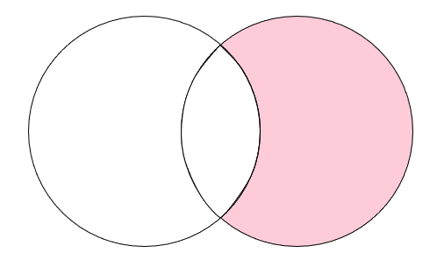
What operations can you perform on sets? How do you add and remove items from sets?
Union: s1 | s2 or s1.union(s2)
Intersection: s1 & s2 or s1.intersection(s2)
Difference: s1 - s2 or s1.difference(s2)
s1
s2

Slide 24
What operations can you perform on sets? How do you add and remove items from sets?
Union: s1 | s2 or s1.union(s2)
Intersection: s1 & s2 or s1.intersection(s2)
Difference: s1 - s2 or s1.difference(s2)
Adding an item: my_set.add(item)
Removing an item: my_set.remove(item)

Slide 25
Exercises!

Slide 26
What is None? How is it used?
Notes:
(Or the return statement is not executed)

Slide 27
What is None? How is it used?
None is a special value:
The thing that’s returned when a function has no return statement
Value we get when we assign to many mutating methods, e.g. .append()
Notes:
(Or the return statement is not executed)

Slide 28
What is None? How is it used?
None is a special value:
The thing that’s returned when a function has no return statement
Value we get when we assign to many mutating methods, e.g. .append()
Represents the absence of a result
Notes:
(Or the return statement is not executed)

Slide 29
What is None? How is it used?
None is a special value:
The thing that’s returned when a function has no return statement
Value we get when we assign to many mutating methods, e.g. .append()
Represents the absence of a result
Its own type (not really Boolean!) so no value of any other type has equality with it!
Notes:
(Or the return statement is not executed)

Slide 30
What is the difference between sorted() and .sort() when applied to a list?

Slide 31
What is the difference between sorted() and .sort() when applied to a list?
Both sorted() and .sort() are able to sort lists

Slide 32
What is the difference between sorted() and .sort() when applied to a list?
Both sorted() and .sort() are able to sort lists
sorted(my_list) returns a new list, containing the items in my_list, sorted
my_list.sort() does not return anything (its value is None)

Slide 33
What is the difference between sorted() and .sort() when applied to a list?
Both sorted() and .sort() are able to sort lists
sorted(my_list) returns a new list, containing the items in my_list, sorted
my_list.sort() does not return anything (its value is None)
sorted(my_list) does not change the value of the variable my_list
my_list.sort() changes the value of the variable my_list

Slide 34
What is the difference between sorted() and .sort() when applied to a list?
Both sorted() and .sort() are able to sort lists
sorted(my_list) returns a new list, containing the items in my_list, sorted
my_list.sort() does not return anything (its value is None)
sorted(my_list) does not change the value of the variable my_list
my_list.sort() changes the value of the variable my_list
.sort() changes the value of my_list in-place

Slide 35
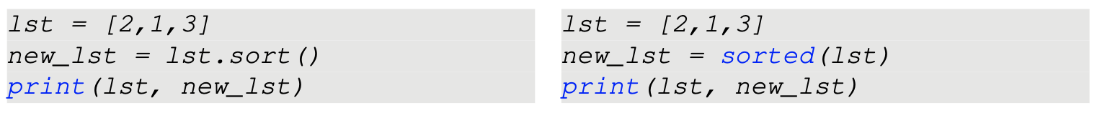
What is the difference between sorted() and .sort() when applied to a list?
For example:

Slide 36
What is the difference between sorted() and .sort() when applied to a list?
For example:
[1,2,3] None
[2,1,3] [1,2,3]

Slide 37
Exercises!

Slide 38
Write a function with takes a string as inputs and print the frequency of each character in the string, using a dictionary
E.g. freq_counts(“booboo”) should print:
b 2
o 4

Slide 39
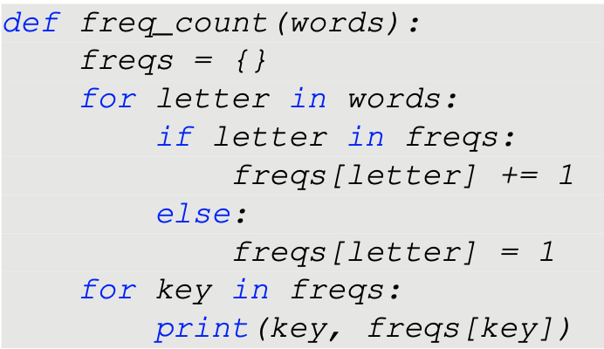
Write a function with takes a string as inputs and print the frequency of each character in the string, using a dictionary
E.g. freq_counts(“booboo”) should print:
b 2
o 4

Slide 40
Write a function which takes two lists as input and returns a list containing the numbers which they both have in common
E.g., in_common([1,2,4], [3,4,5]) should return [4]

Slide 41
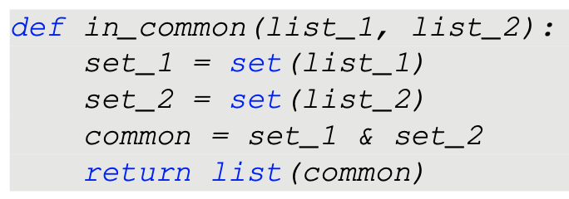
Write a function which takes two lists as input and returns a list containing the numbers which they both have in common
E.g., in_common([1,2,4], [3,4,5]) should return [4]

